Slide 1







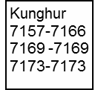


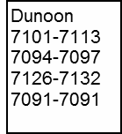

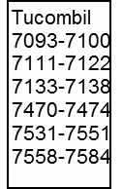

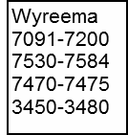
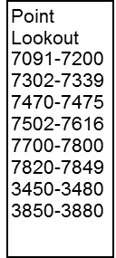

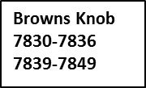




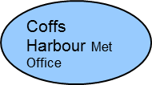

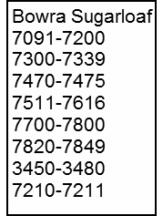


NORTH COAST ERTS REPEATER NETWORK- PASS RANGES
Last updated 24/09/2010
Limpinwood 3467-3469
7157-7159
7175
Tweed UDP
Chincogen
7148-7200
7530-7584
7470-7473
3450-3490
Byron UDP
OOHB
OOHS
0
Tuckombil
3G
From Mt Rumbee
UDP

